Slide 1
Lecture 33
Slab and Gap Surface Plasmon Polaritons

Slide 2
SPP’s in thin metal layers
SPP2
SPP1
SPP2
ω_{sp2}
ω_{sp1}
What happens when the metal is thin (less than skin depth) and two SPPs are coupled ?
SPP1

Slide 3
Slab SPP
x
Inside the metal
+a/2
0
In the cladding
-a/2
Boundary condition –continuous E_{z}
Same for odd mode –
cosh in place of sinh
Introduce
For odd mode
Skin depth

Slide 4
Slab SPP
Graphic solution
Gold on glass
Odd solution always has larger v than even solution. Therefore the even solution spreads more into dielectric and has lower loss than odd solution, which is well confined to the meta, therefore even solution has longer propagation range
W=0.1
W=0.5
W=1
W=0.25
As long as
odd
even

Slide 5
Slab SPP
Gold on glass
Magnetic field
1.5
even
odd
1
y
0.5
H
0
odd
a=30nm
-0.5
even
-1
-600
-400
-200
0
200
400
600
distance (nm)
4
even
2
even
y
H
0
odd
a=100nm
-2
odd
-4
-600
-400
-200
0
200
400
600
distance (nm)

Slide 6
Dispersion of Slab SPP’s
Electric field
Long range plasmon (even)
1.2
Long range plasmon (even)
1
Short range plasmon (odd)
0.8
|
x
E
0.6
|
0.4
Short range plasmon (odd)
a=12nm
0.2
0
-600
-400
-200
0
200
400
600
distance (nm)
Long range plasmon (even)
Short range plasmon (odd)

Slide 7
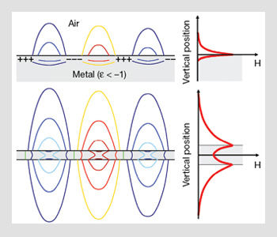
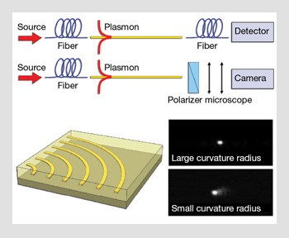

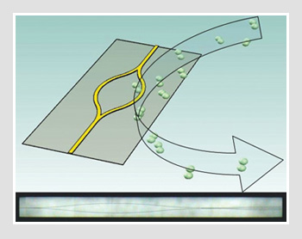
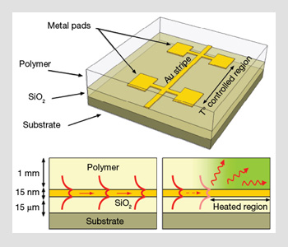
Guiding Light with Long-Range Plasmons
The thermo-optic attenuator depicted here consists of a metal stripe sandwiched between a layer of SiO₂ and a polymer having different thermo-optic properties. At room temperature, the long-range plasmon can propagate because the chosen polymer is index-matched to SiO₂. When the temperature rises, the index of the polymer becomes different than that of the SiO₂. The resulting asymmetry strongly attenuates the mode, which becomes radiative
MZI Sensor
Thermo optic attenuator

Slide 8
Gap (slot) SPP
x
Inside the dielectric gap
+a/2
z
In the metal cladding
E_{x}
0
-a/2
y
Longitudinal electric field
Boundary condition –continuous E_{z}
Introduce
For odd mode
Skin depth

Slide 9
Gap SPP
Graphic solution
Gold with air gap
Odd solution does not exist!
odd
W=1
even
W=0.5
W=0.25
W=0.1
As long as
The effective index of gap mode n_{eff}=β/k₀ has a very weak frequency dependence for as long as gap is larger than skin depth

Slide 10
Gap SPP
λ=600nm
λ=750nm
λ=1500nm
λ=1000nm
λ=1500nm
λ=1000nm
λ=750nm
λ=600nm
Magnetic field
λ=750nm
Electric field
1.2
1
λ=500nm, 750nm,1000nm
0.8
x
E
0.6
0.4
0.2
0
-150
-100
-50
0
50
100
150
distance (nm)
This is a standard TEM wave in a metal transmission line –it has very little to do with a “real” plasmon

Slide 11
Where is the odd solution?
x
Inside the dielectric gap
+a/2
In the metal cladding
0
y
-a/2
Longitudinal electric field
Boundary condition –continuous E_{z}
Introduce
For odd mode

Slide 12
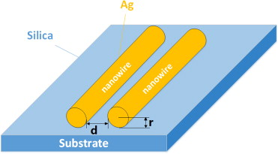
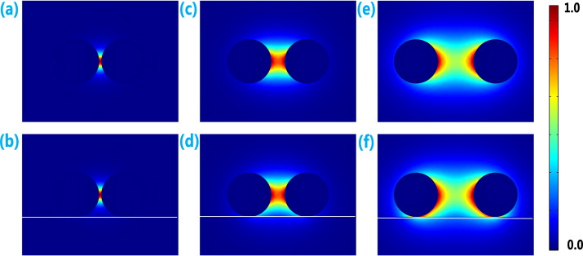
Other TM solutions
TM1
(odd)
Solutions are all close to normal metal waveguide modes
TM2
(even)
Round trip phase delay of 2mπ
Instead of TM0 there exists TEM wave – a very special wave indeed.
Must be real
No TM0!!!
λ=700nm
TEM
TM1
cutoff

Slide 13
Plasmonic circuits

Slide 14
Confinement vs. Loss

Slide 15
Confinement vs. Loss

Slide 16
Plasmonic nanolasers

Slide 17
Plasmonic modulators

Slide 18
Hybrid mode modulator

